Slide 1
Our with journey with Teams – so far!
Esam Baboukhan

Slide 2
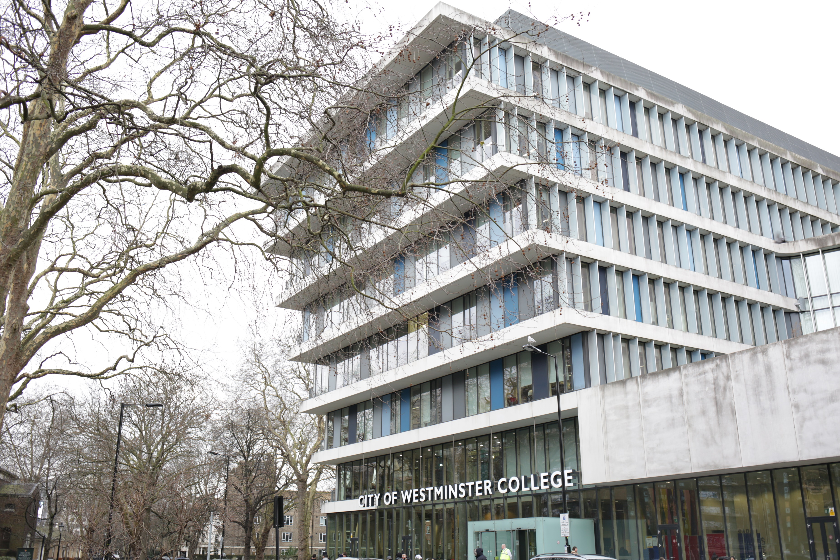
Notes:
Option: Full-page photo with bottom tint, HTC graphic

Slide 3
Our with journey with Teams – so far!
Started in November 2017
Experimented with Teams
Now integrated in most ICT and English courses and growing

Slide 4

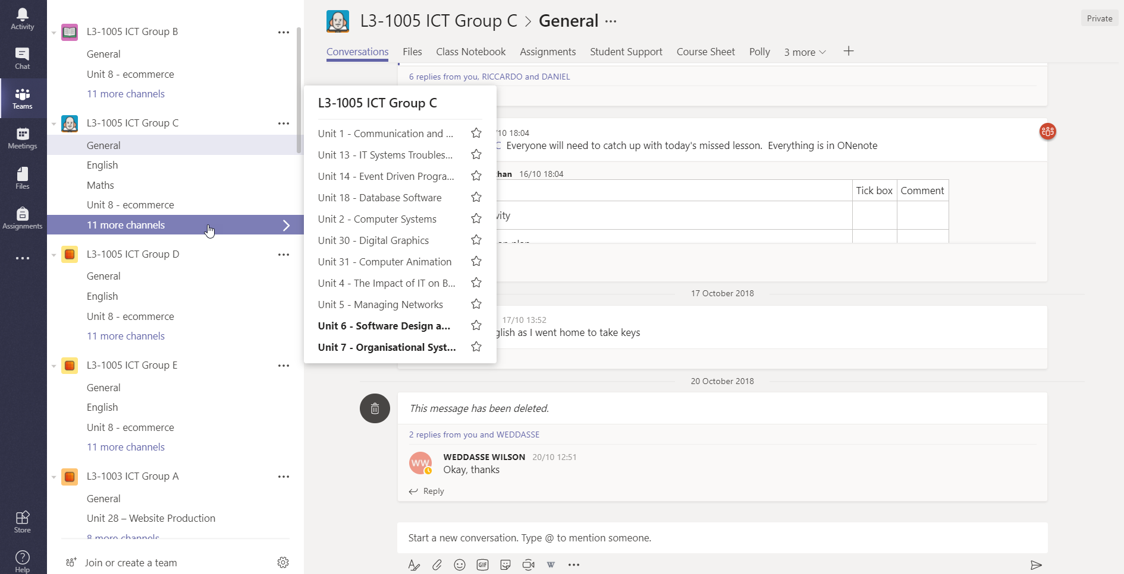
Notes:
Full-page framed photo

Slide 5
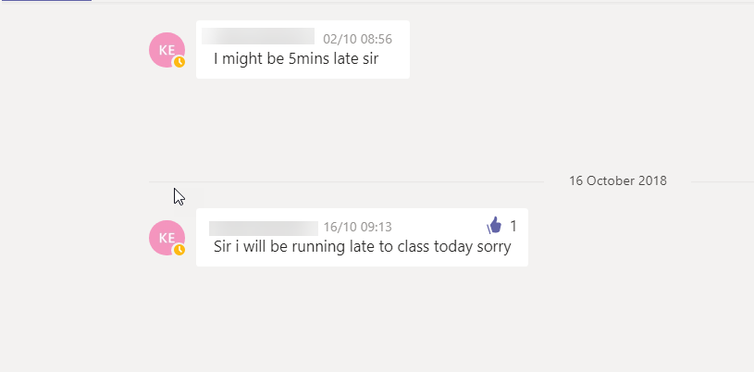

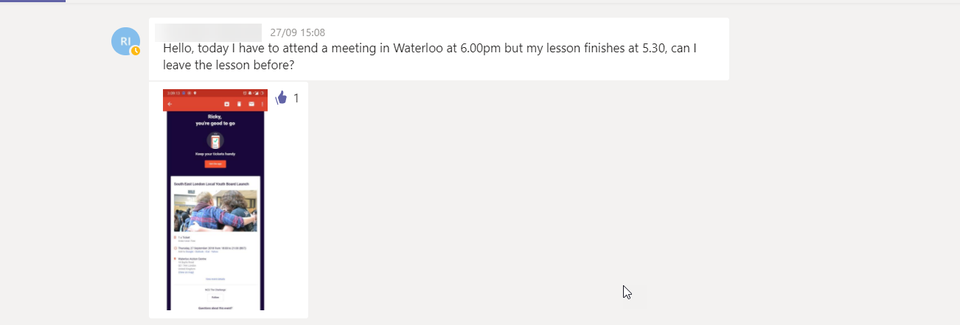
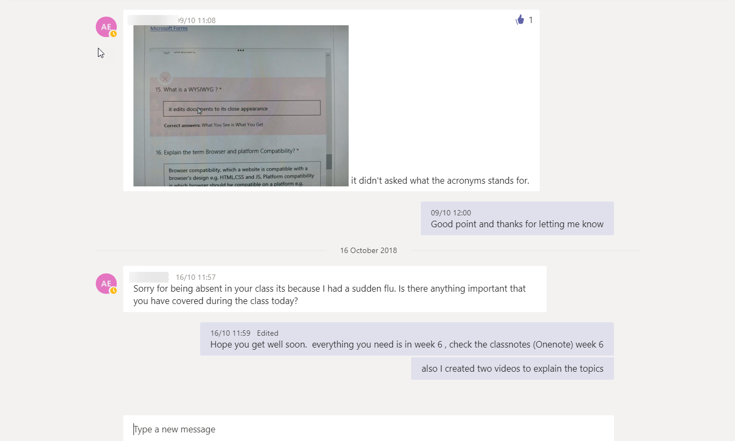
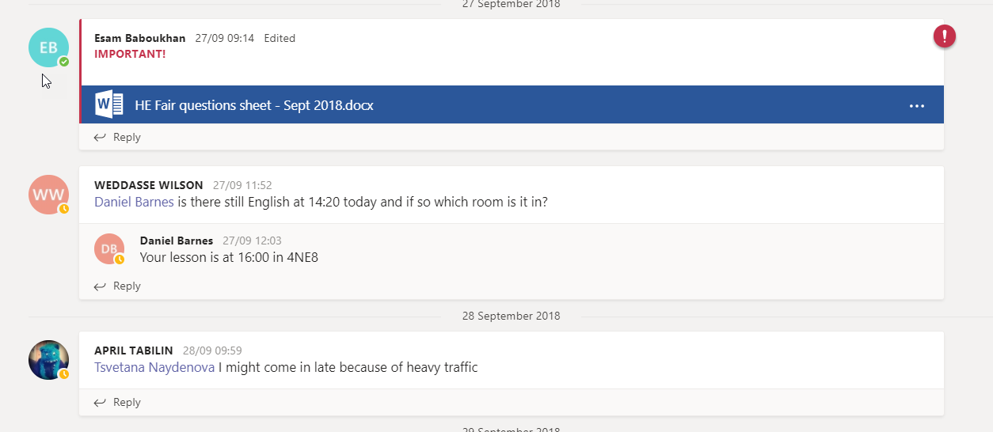

Slide 6

Notes:
Full-page photo

Slide 7
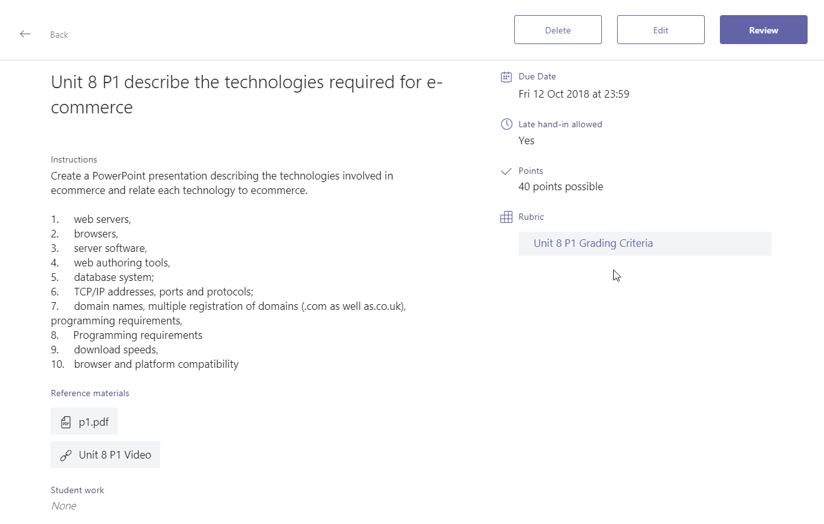
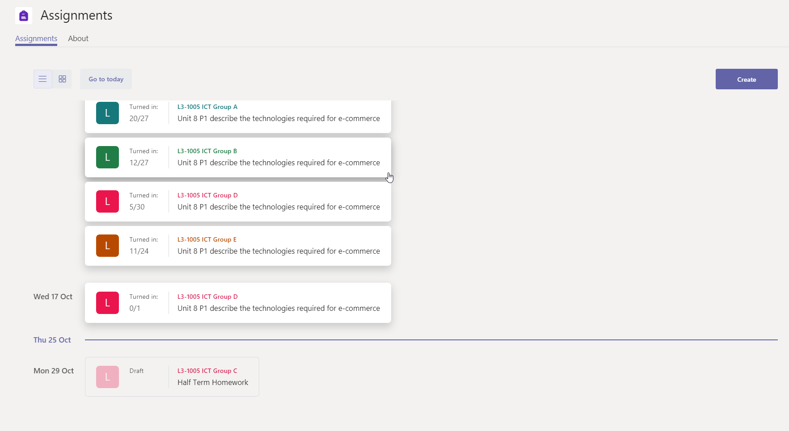
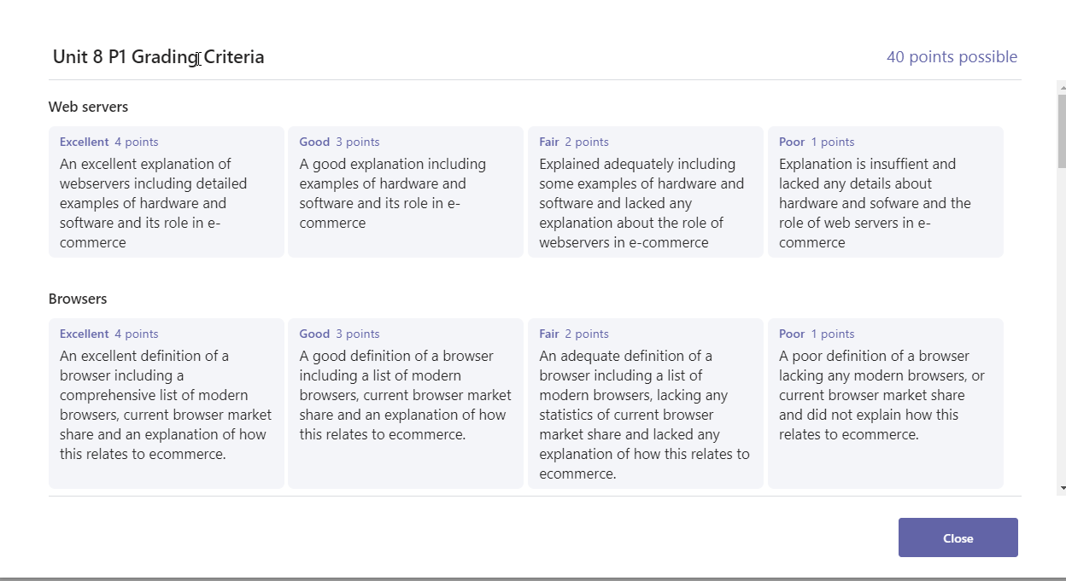
Assignments
Notes:
Full-page framed photo

Slide 8
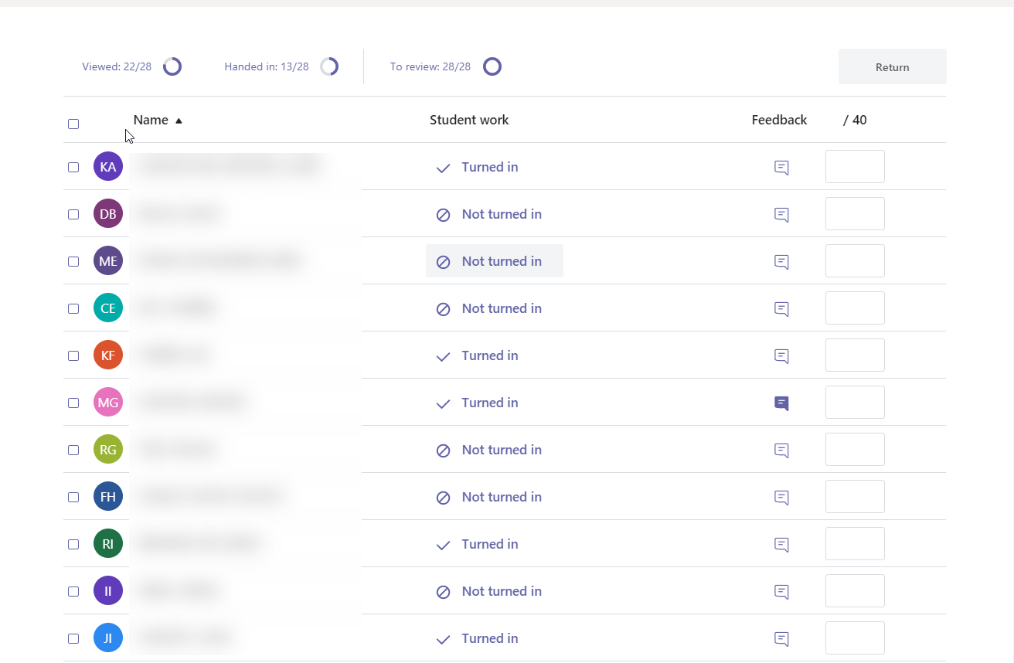
Assignments

Slide 9
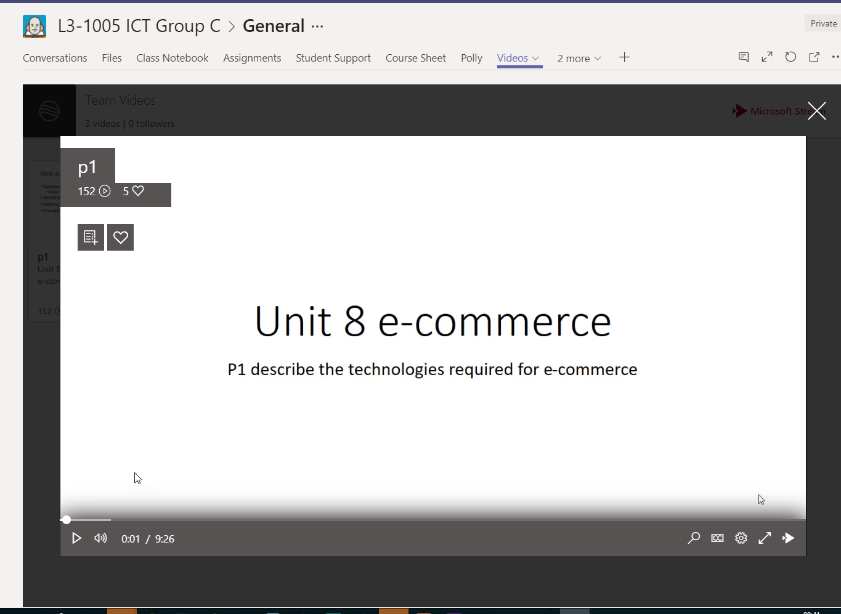
Streams
Notes:
Full-page framed photo

Slide 10
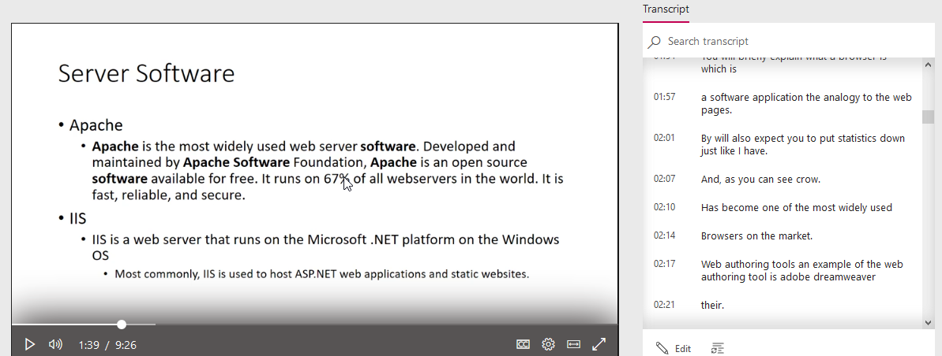


Slide 11
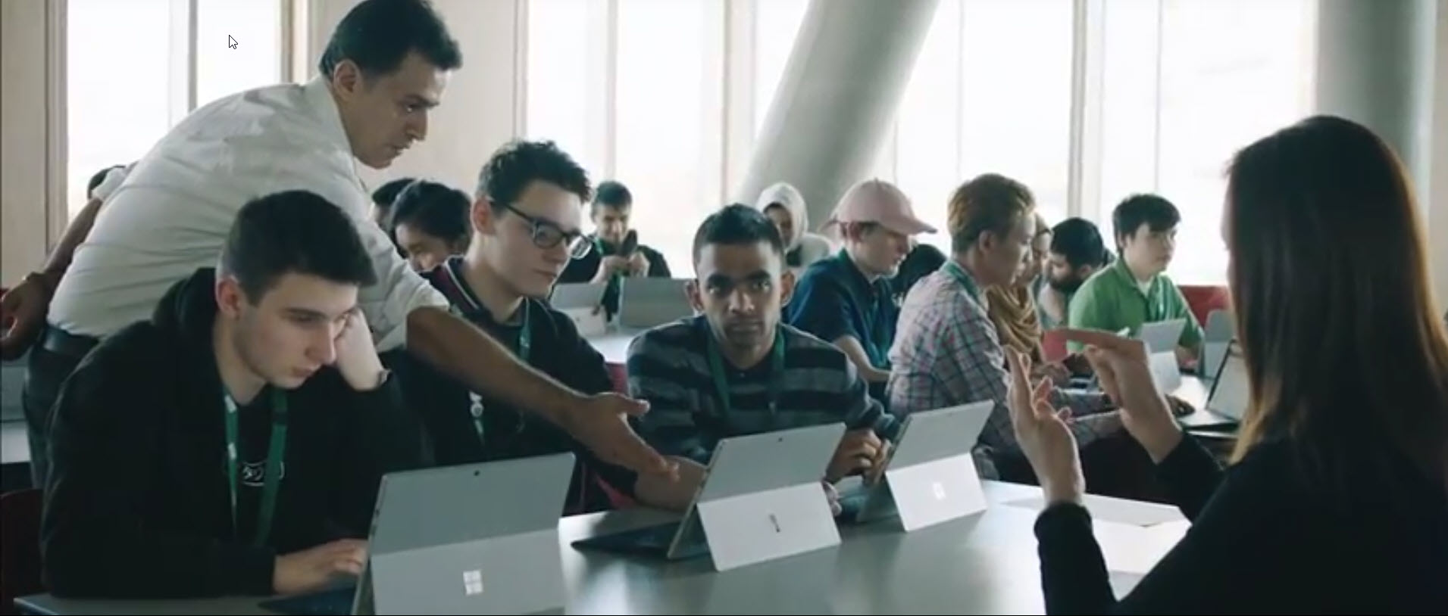

Slide 12
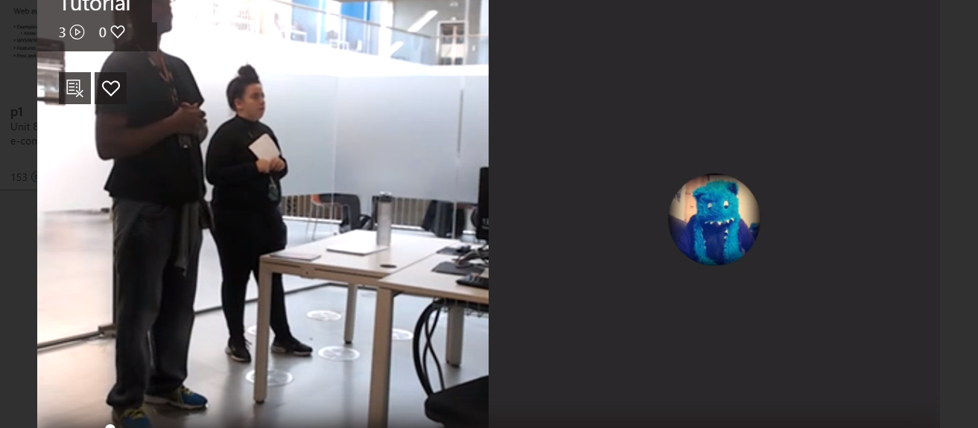

Meet Now
Notes:
I’ve had a few times when students messaged me when they were sick and it was a time when

Slide 13
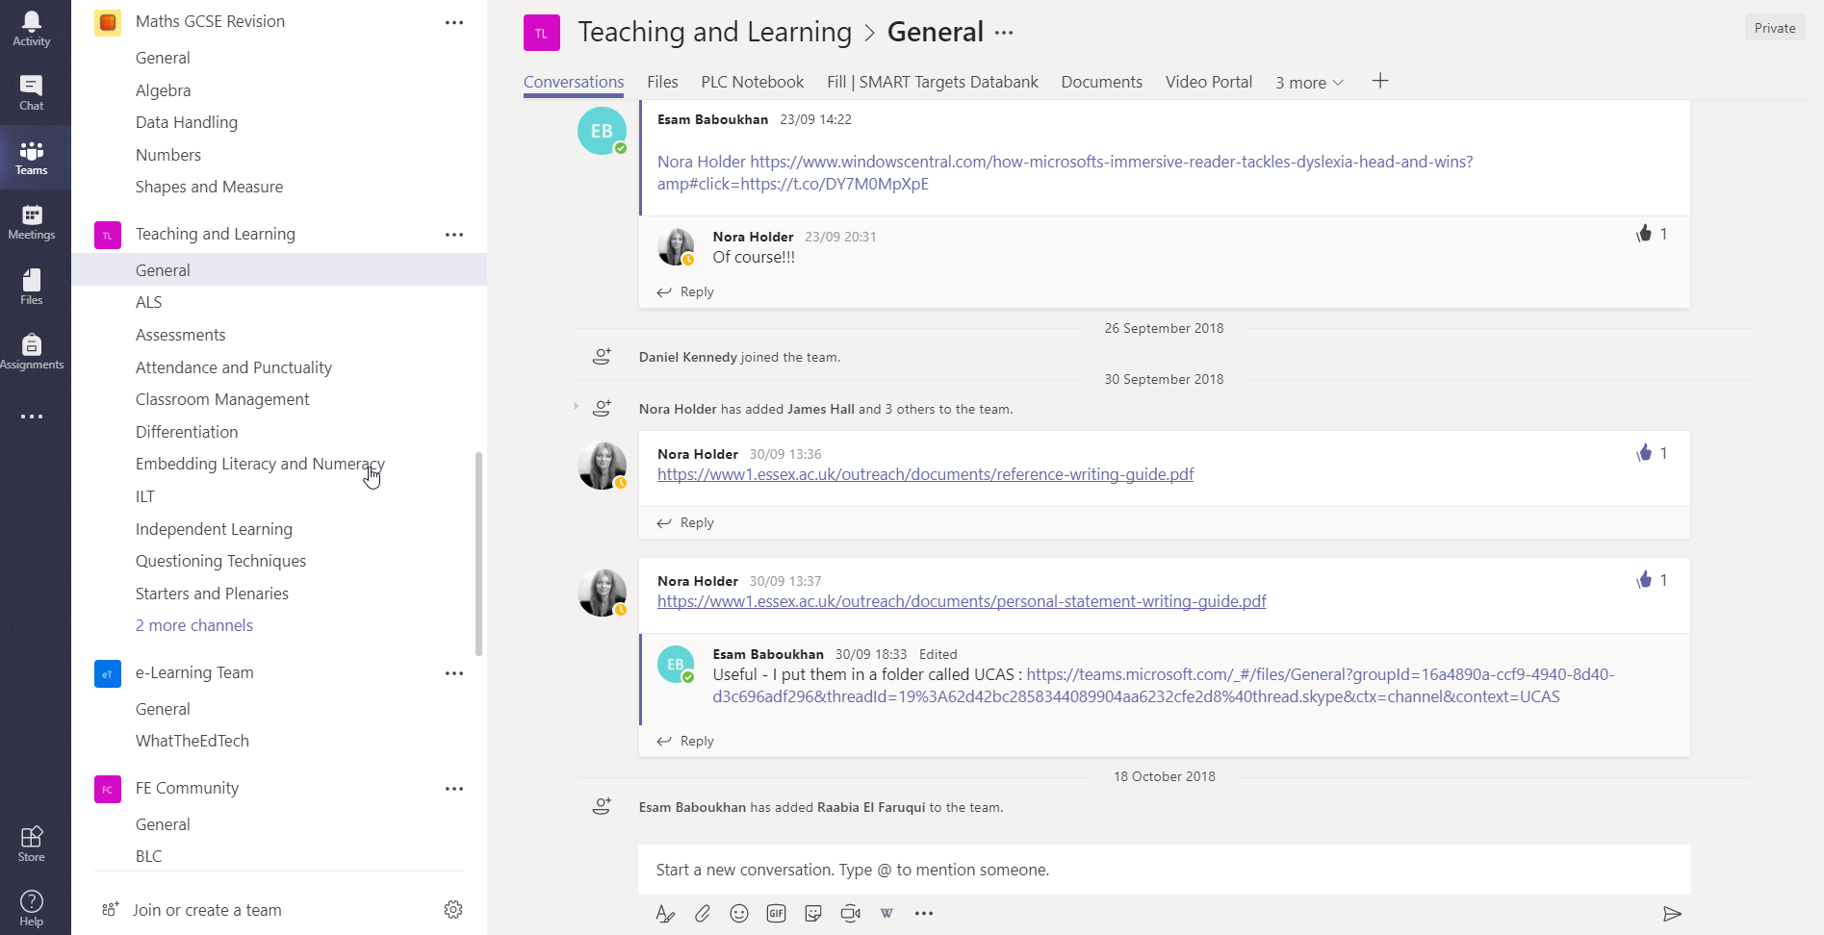
Professional Development
Notes:
Full-page framed photo

Slide 14
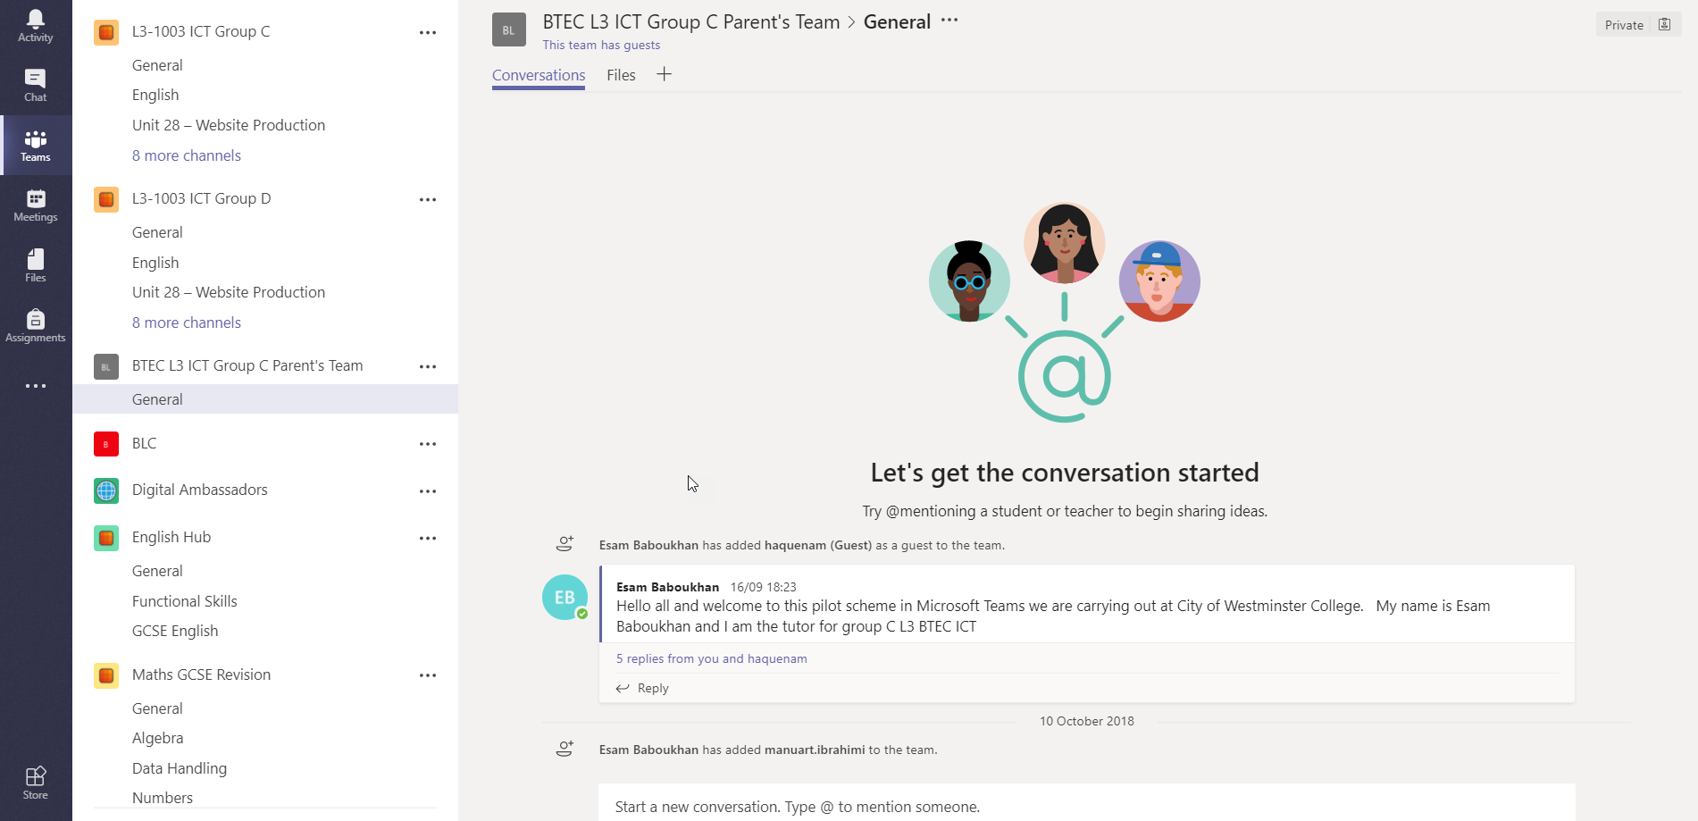
A Team for parents

Slide 15
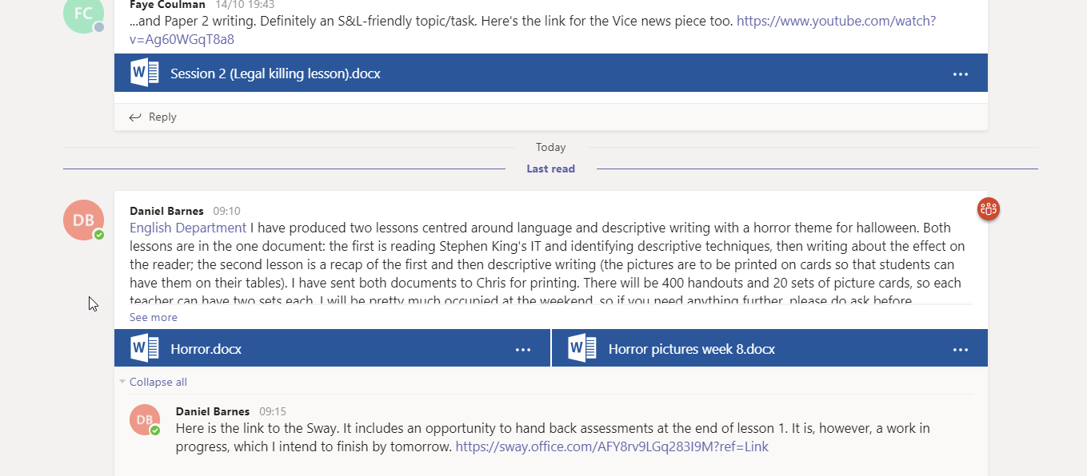
Communication and Collaboration

Slide 16
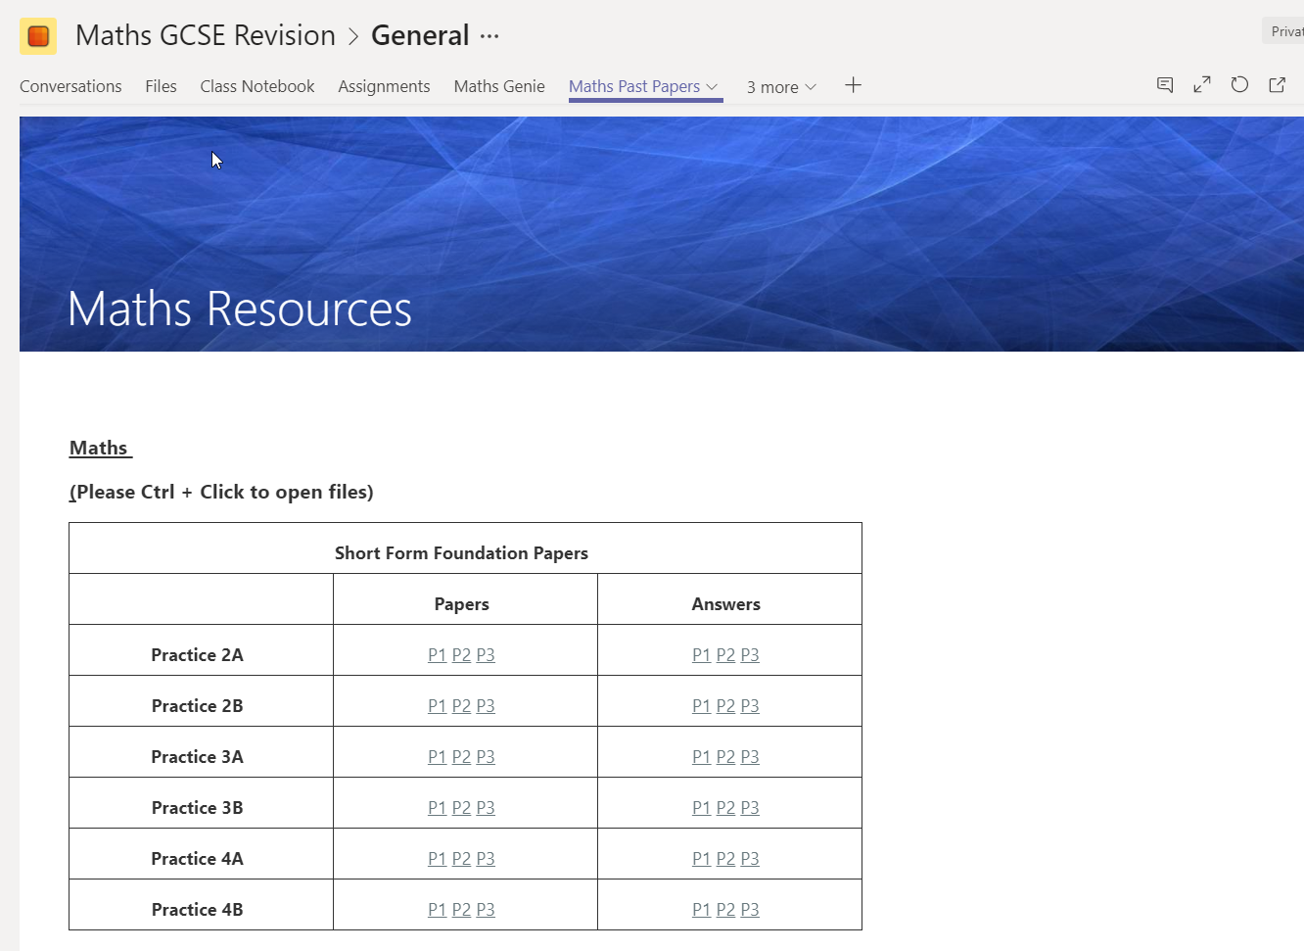

English and Math Teams
Notes:
Full-page framed photo

Slide 17
Greater student engagement-they love the interactivity/being able to use their phones for learning
It allows them to access one-to-one support at the drop of a hat e.g. "Miss, did we have homework for literature?" Then ask for more (individualized) detail
Contributes to greater learner autonomy/differentiated learning
For the new, linear 2-year, A-level, it helps students keep track of all their independent learning resources/class materials/in one place
Instant collaboration e.g. sharing of wider research to generate group discussion, which does not necessarily mean all students need to contribute - they can "lurk and learn".
Building confidence: when less confident students feel ready, they can try out their ideas in a safe environment
Feedback

Slide 18


Slide 19
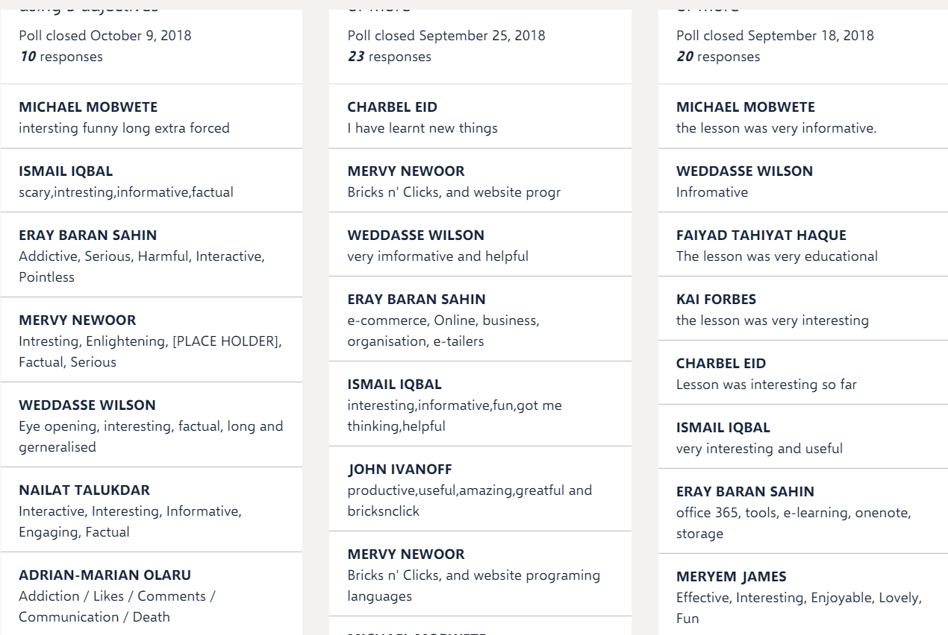
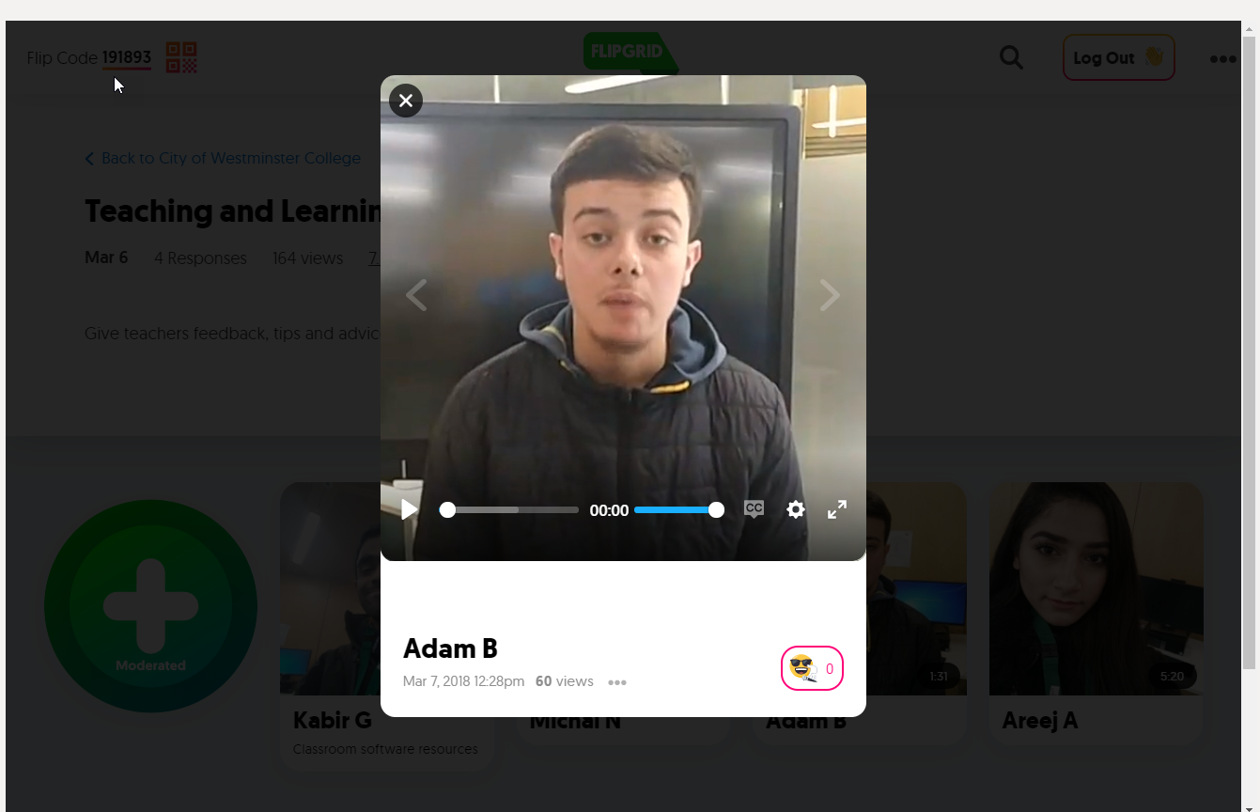
Third-Party apps

Slide 20
Future developments
Moodle Bot
AI and Machine Learning Bots
SCORM Compliancy

Slide 21
Questions/Issues/Debates
Should teachers be contactable any time / anywhere?
The voice/video capabilities - should they be disabled for students?
Should private messages be disabled between learners and the ability of learners to create teams also be disabled?
Can we monitor students' communications and should we even be allowed to?
Who is responsible if something untoward happens as a result of students using teams?
Will it replace a fully fledged VLE?

